Slide 1
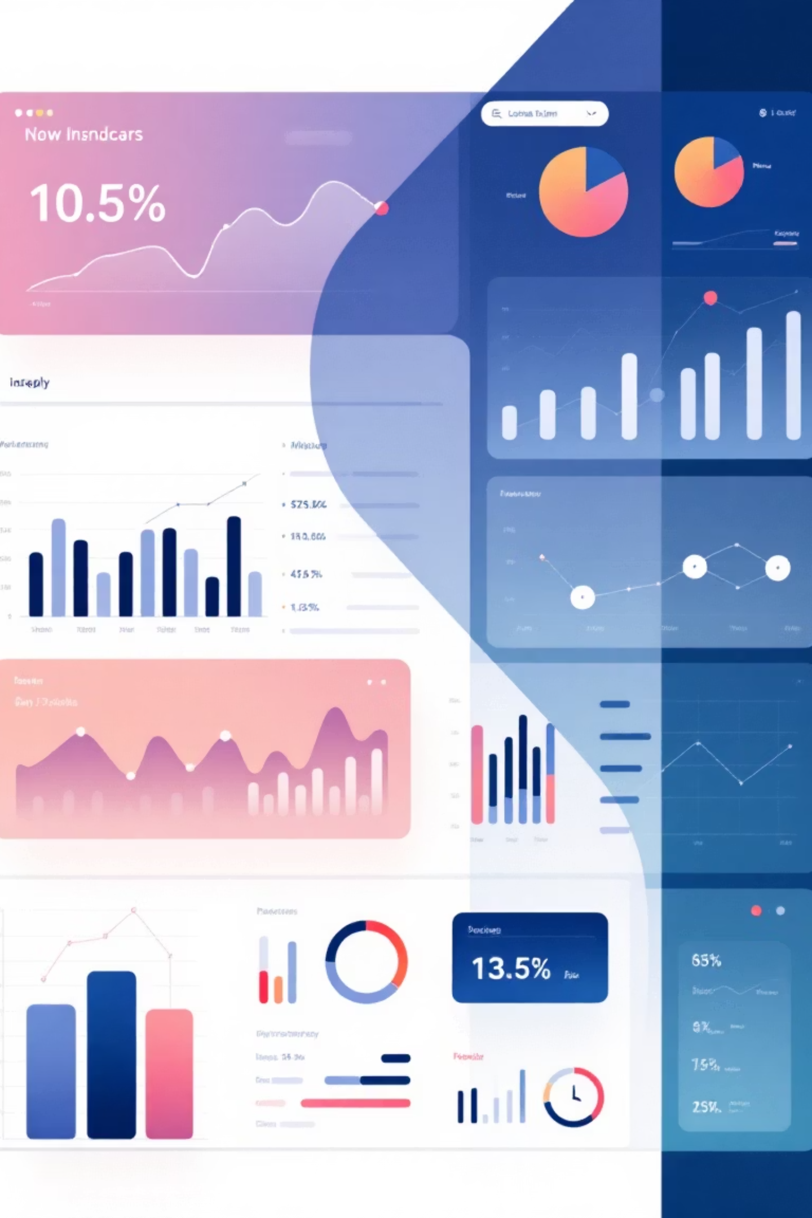
Northwind Traders - Sales Analytics & Business Intelligence
Comprehensive data analysis and strategic insights to drive business growth through advanced SQL analytics and Power BI visualization
Presented By : Rupesh Gupta
Course: Data Analytics
Date: 12th Sept 2025

Slide 2

Project Objectives & Methodology
Strategic Goals
Transform raw business data into actionable insights using comprehensive SQL analysis and interactive Power BI dashboards to optimize sales performance and operational efficiency.
01
SQL Data Analysis
Deep dive into transaction patterns and customer behavior
02
Power BI Dashboards
Interactive visualizations for real-time business monitoring
03
Exploratory Data Analysis
Uncovering hidden trends and growth opportunities

Slide 3

Key Business Metrics Overview
$1.35M
830
91
Total Revenue
Total Orders
Active Customers
Generated across all product categories and customer segments
Processed through our global distribution network
Spanning multiple geographic regions and industries
8
Product Categories
Diverse portfolio serving varied market segments

Slide 4
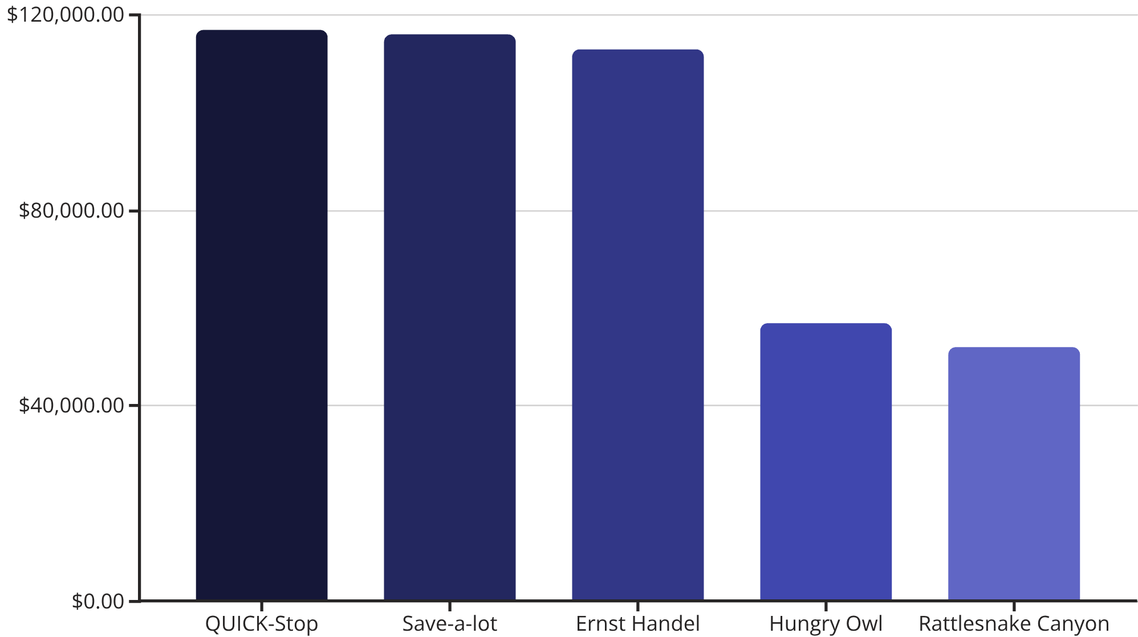

Customer Analysis - Top Revenue Generators
Customer Insights
Our top three customers—QUICK-Stop, Save-a-lot, and Ernst Handel—collectively represent nearly 26% of total revenue, highlighting strong customer loyalty and the importance of strategic account management.
Key Finding: Top 5 customers generate 42% of total revenue, indicating concentrated value in key relationships.

Slide 5

Sales Performance by Product Category
Beverages Leading
Seasonal Patterns
Growth Opportunities
$286K Revenue
Q3 Decline Identified
Category Expansion
Strongest performing category with consistent demand across all customer segments and geographic regions
Notable revenue dip in third quarter suggests seasonal impact requiring strategic inventory and marketing adjustments
Underperforming categories present strategic opportunities for targeted marketing and product development initiatives

Slide 6

Employee Performance & Geographic Distribution
Top Performing Sales Representatives
1
Margaret Peacock
156 orders processed - Leading performer with exceptional customer relationship management and consistent sales excellence
2
Janet Leverling
127 orders processed - Strong regional performance with specialized industry knowledge and client retention expertise
3
Nancy Davolio
123 orders processed - Consistent high-volume sales with focus on strategic account development
Geographic Insights
Sales distribution analysis reveals concentrated performance in key regions, with opportunities for expansion into underserved markets through strategic territory planning.

Slide 7



Operational Insights & Efficiency Metrics
Delivery Performance
Inventory Management
Shipping Cost Analysis
8.49 days average delivery time
Stock optimization potential
Cost efficiency opportunities
Current shipping performance meets industry standards but presents opportunity for competitive advantage through optimization initiatives
Analysis reveals inventory imbalances across product categories, suggesting need for demand forecasting improvements and automated reorder systems
Freight expense patterns indicate potential savings through carrier negotiations and route optimization strategies

Slide 8




Strategic Recommendations
Customer Retention Program
Implement targeted loyalty initiatives for top-tier customers while developing strategies to elevate mid-tier accounts to premium status
Geographic Expansion
Leverage successful regional models to penetrate underserved markets and establish new distribution channels in high-potential territories
Inventory Optimization
Deploy predictive analytics and automated inventory management to reduce carrying costs while improving product availability and customer satisfaction

Slide 9
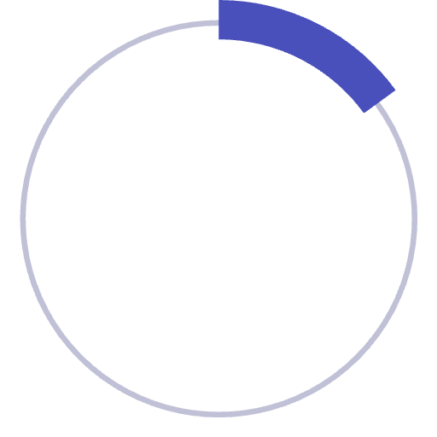
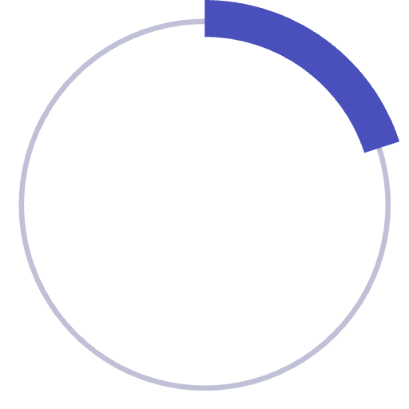

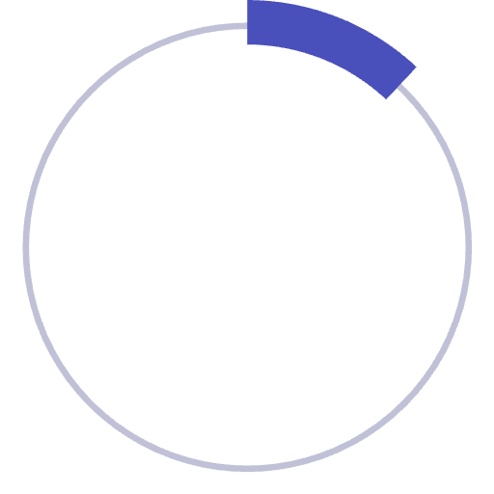
Expected Business Impact
15%
20%
Conservative Growth
Optimistic Scenario
Minimum expected revenue increase through operational improvements
Potential growth with full implementation of strategic recommendations
12%
Cost Reduction
Projected operational efficiency gains through process optimization
"Data-driven insights combined with strategic execution will position Northwind Traders for sustained competitive advantage and profitable growth."

Slide 10

Next Steps & Implementation Timeline
Phase 1: Foundation (30 days)
1
Deploy enhanced Power BI dashboards and establish automated reporting systems for real-time business monitoring and decision-making capabilities
2
Phase 2: Optimization (60 days)
Implement customer retention programs and begin geographic expansion initiatives while optimizing inventory management processes
Phase 3: Growth (90 days)
3
Execute full strategic recommendations and measure impact against established KPIs to ensure sustainable business growth and profitability
Ready to transform data insights into measurable business results

